Slide 1

SportswearXpress
AI-Enhanced Sportswear Customization Platform
SportWearXpress

Slide 2

Presented by
Awais Akram
Qasim Abbas
Muneeb Butt
L1S21BSSE0072
  L1F21BSSE0476
L1F21BSSE0564
SportWearXpress

Slide 3
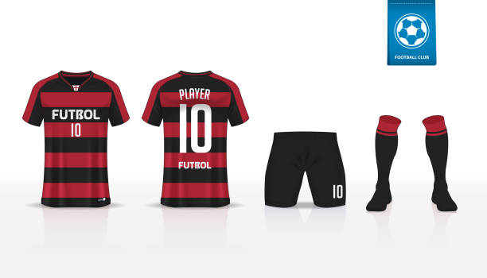
INTRODUCTION
SportswearXpress is an AI-driven e-commerce platform designed to enhance sportswear customization. It integrates AI-powered design tools, dynamic pricing, and real-time communication to streamline the process. Traditional platforms lack intelligent guidance, leading to errors and inefficiencies. Our platform provides precise customization, instant pricing updates, and seamless interaction between buyers and sellers, ensuring a better user experience
SportWearXpress

Slide 4
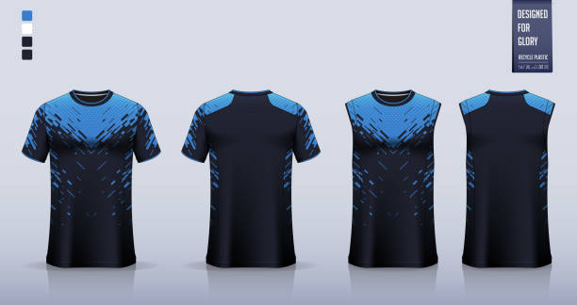
PROBLEM STATEMENT
Existing sportswear customization platforms lack AI-powered tools, dynamic pricing, and real-time communication, leading to inefficiencies and poor user experience. Customers struggle with inaccurate designs, unpredictable costs, and miscommunication with sellers. SportswearXpress solves these issues by offering intelligent design assistance, automated pricing based on complexity, and seamless buyer-seller interaction.
SportWearXpress

Slide 5
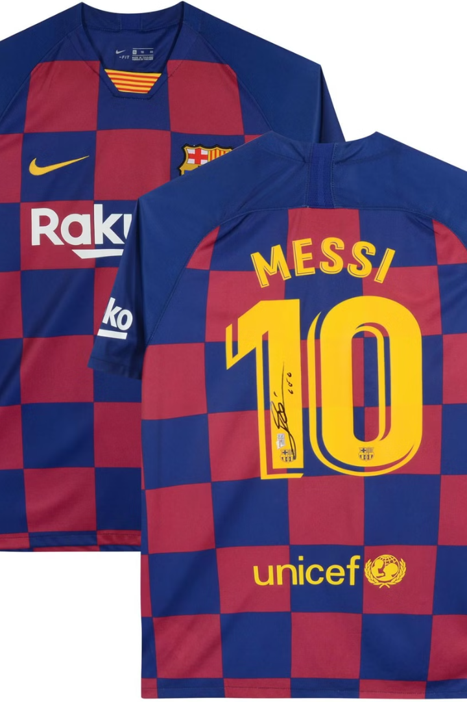
PURPOSE AND OBJECTIVES
Purpose: SportswearXpress aims to revolutionize sportswear customization by integrating AI-driven design tools, real-time communication, and dynamic pricing. The platform enhances user experience by providing precise design assistance, seamless interaction between buyers and sellers, and automated pricing based on customization complexity. Our goal is to create a scalable, efficient, and user-friendly solution that sets a new standard in personalized sportswear shopping
SportWearXpress

Slide 6
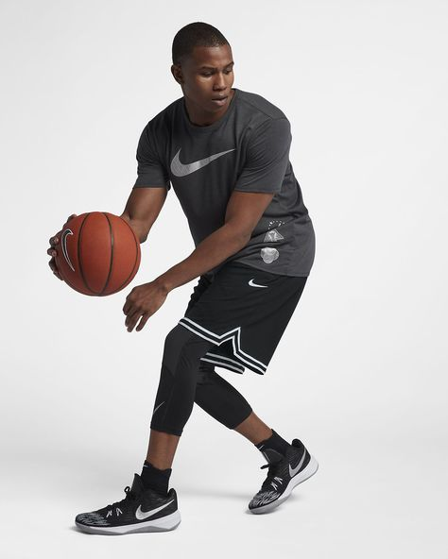
OBJECTIVES
1
AI-powered design assistance for precise customization
2
Dynamic pricing based on design complexity
Real-time communication
between
buyers and sellers
Increase Customer
Satisfaction
3
4
Reduce vendor
distraction
5
SportWearXpress

Slide 7
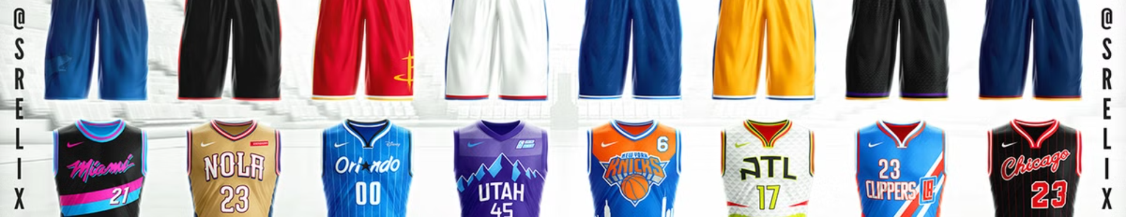
FEATURES
1) AI-Powered Design Tools
2) Real-Time Communication
3) AI-Powered Design Tools
4) Dedicated User Interfaces
5) Admin Dashboard & Analytics
SportWearXpress

Slide 8
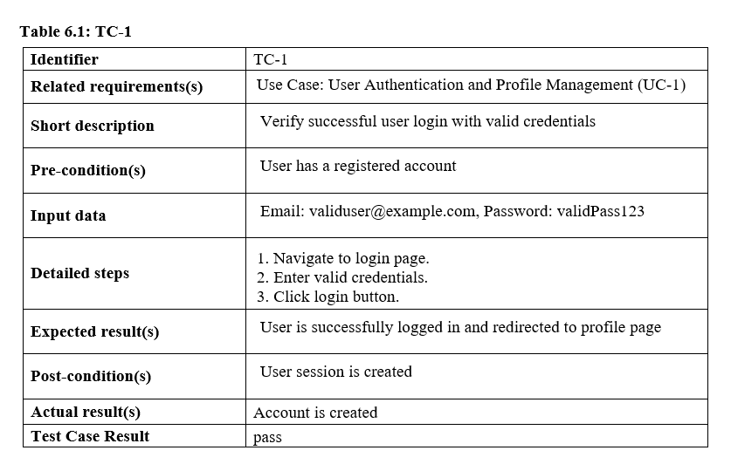
USER AUTHENTICATION

Slide 9
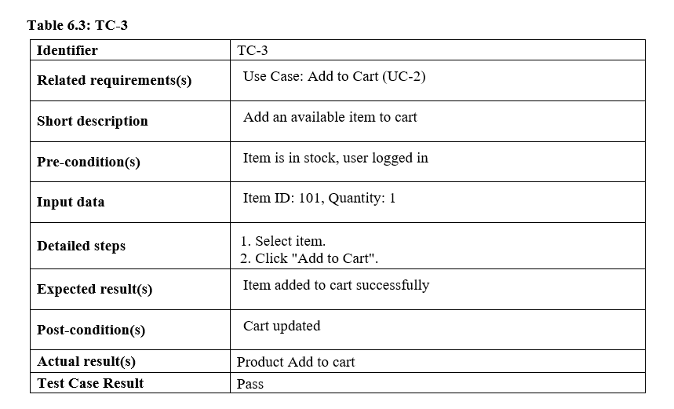
ADD TO CART

Slide 10
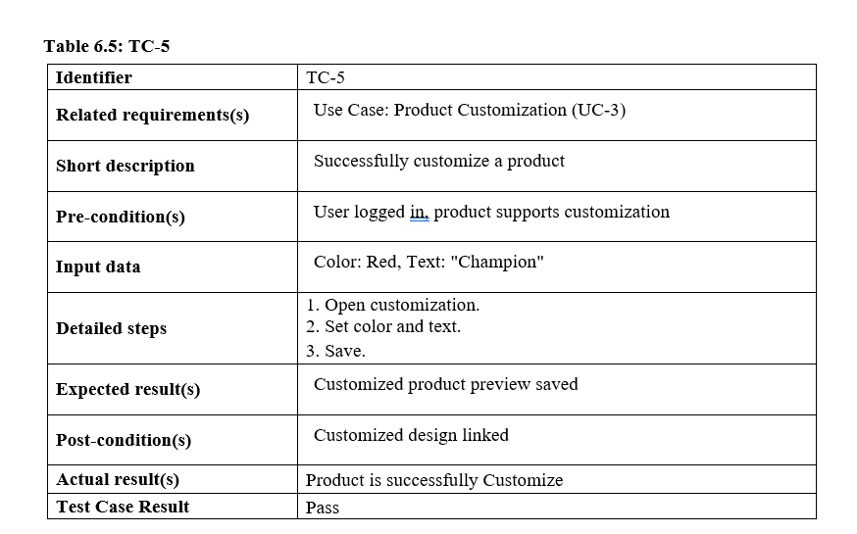
Product Customization

Slide 11
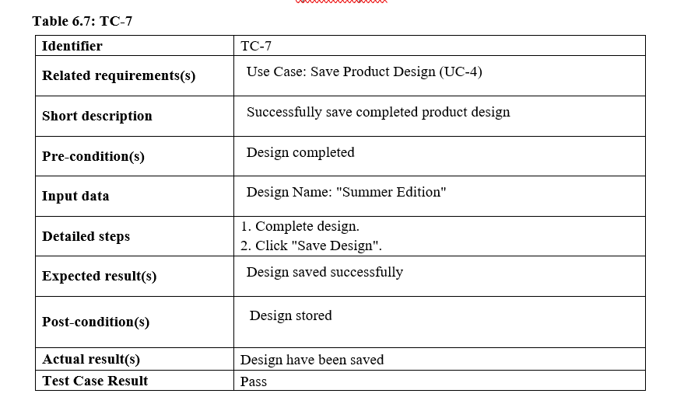
Save Product Design

Slide 12
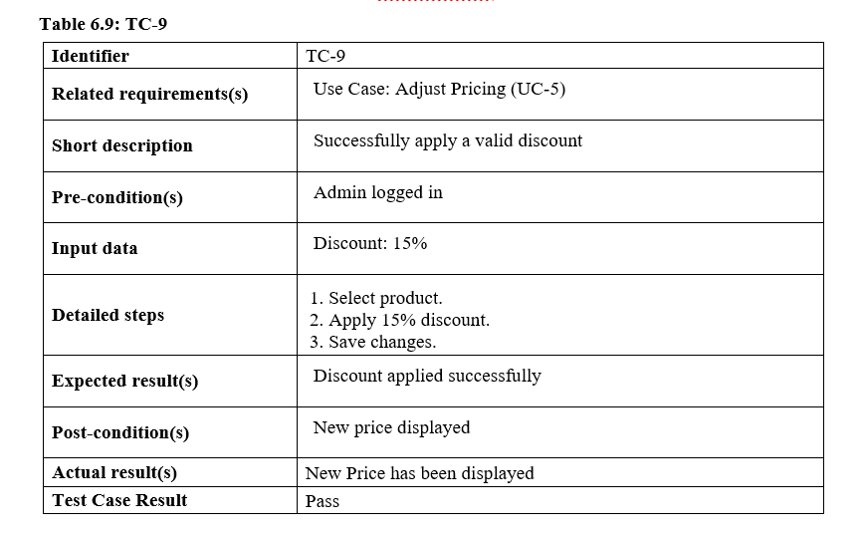
Adjusting Pricing

Slide 13
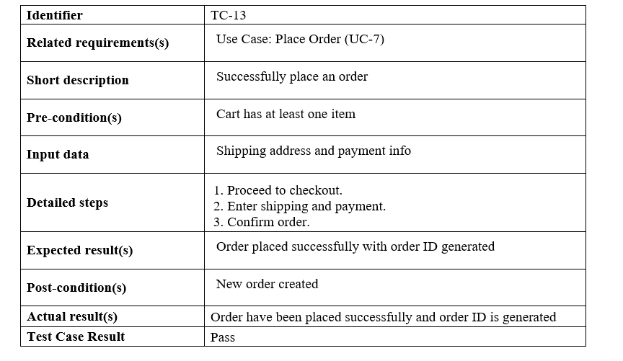
Place Order

Slide 14
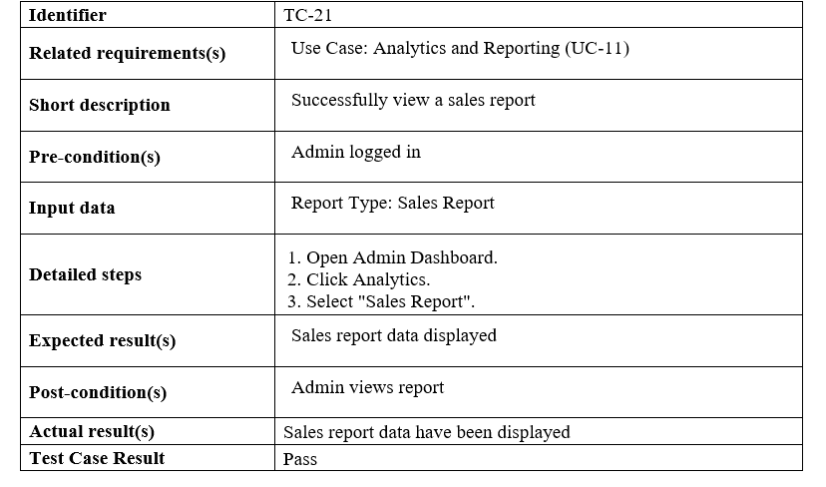
Analytics and Reporting

Slide 15
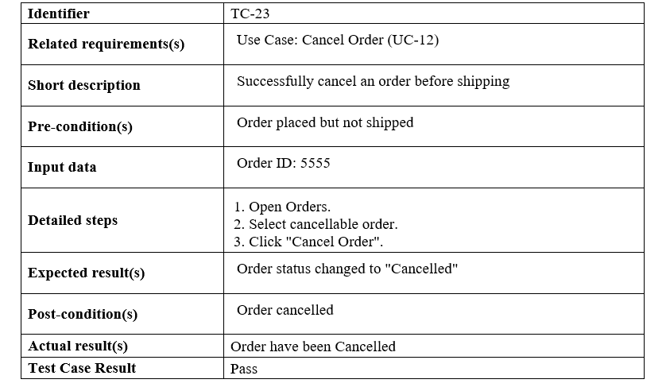
Cancel Order

Slide 16
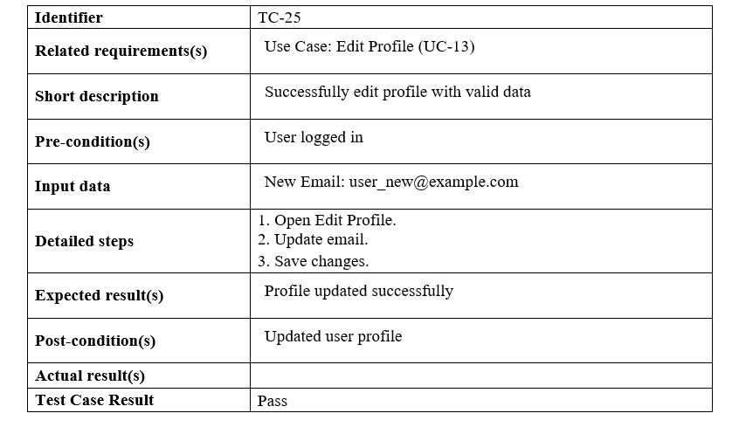
Edit Profile

Slide 17
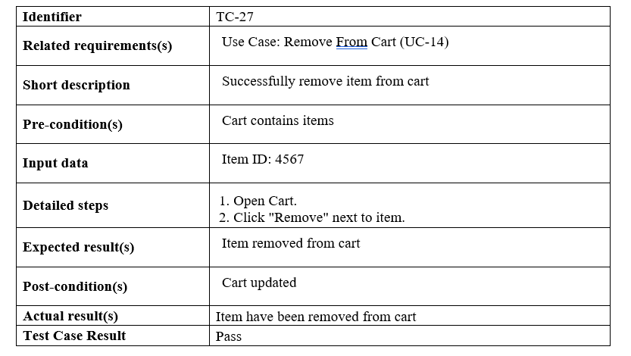
Remove From Cart

Slide 18
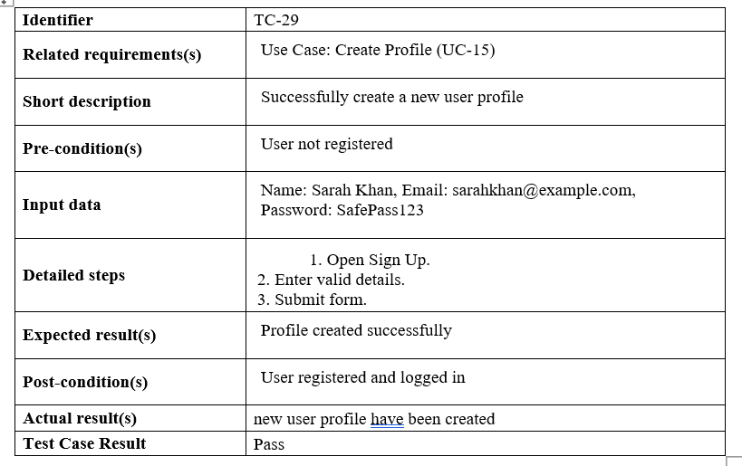
Create Profile

Slide 19
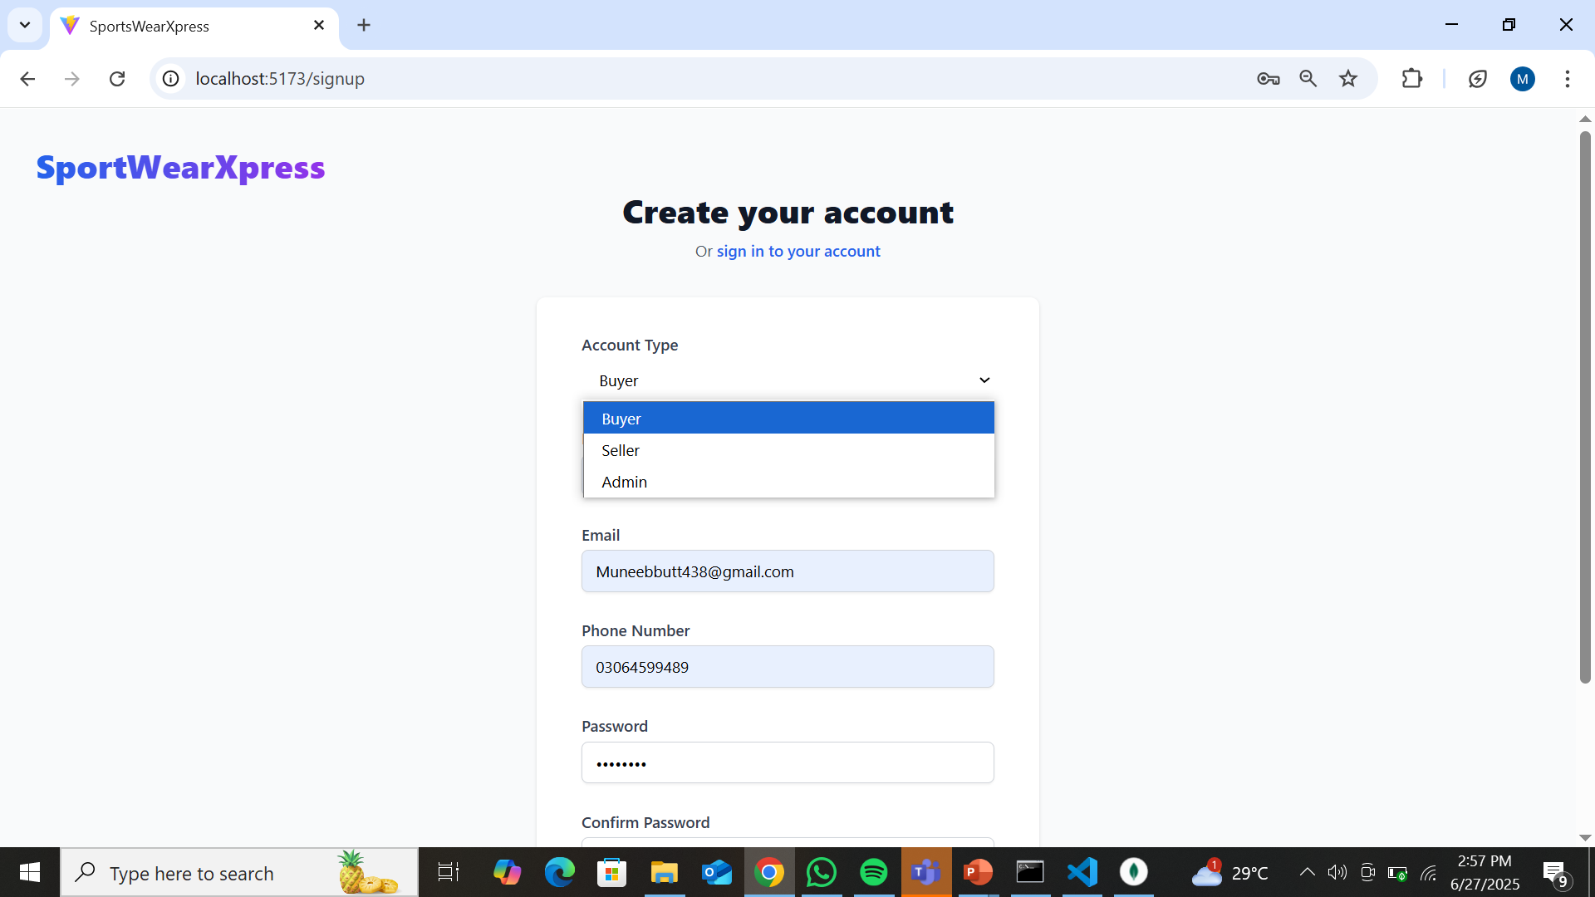
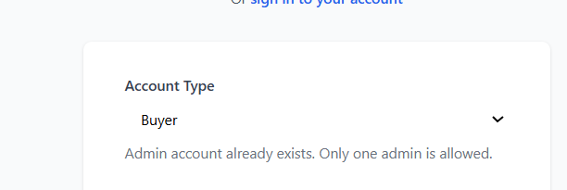
Sign up For Admin
Three Type of Accounts
Choosing Admin
Once the Admin has been made
, no more Admin Accounts

Slide 20
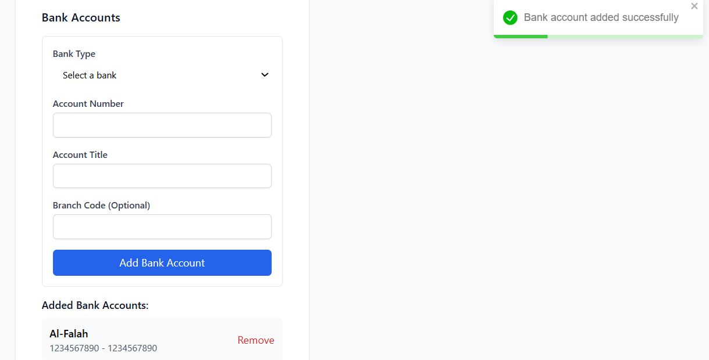
Showing that the Bank Acount has been Added

Slide 21
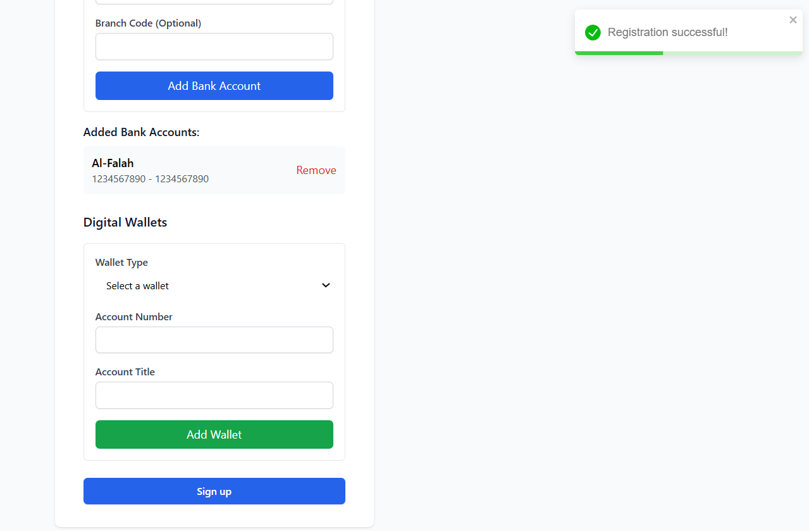
Showing that the Sign up IS Successfull
Only Wallet Is Required Bank or
Digital Wallet

Slide 22
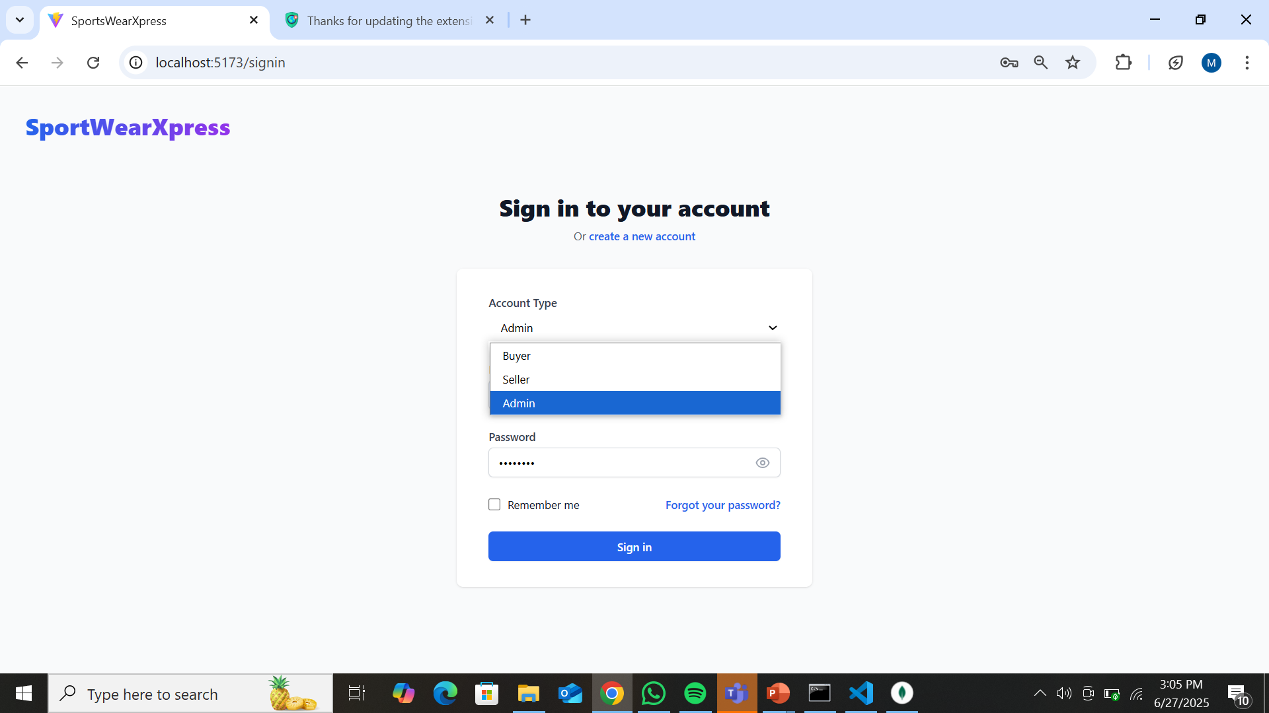
Sign in For Admin
Chosing Admin During Login
After Correct Sign in the Admin Dashboard opens

Slide 23
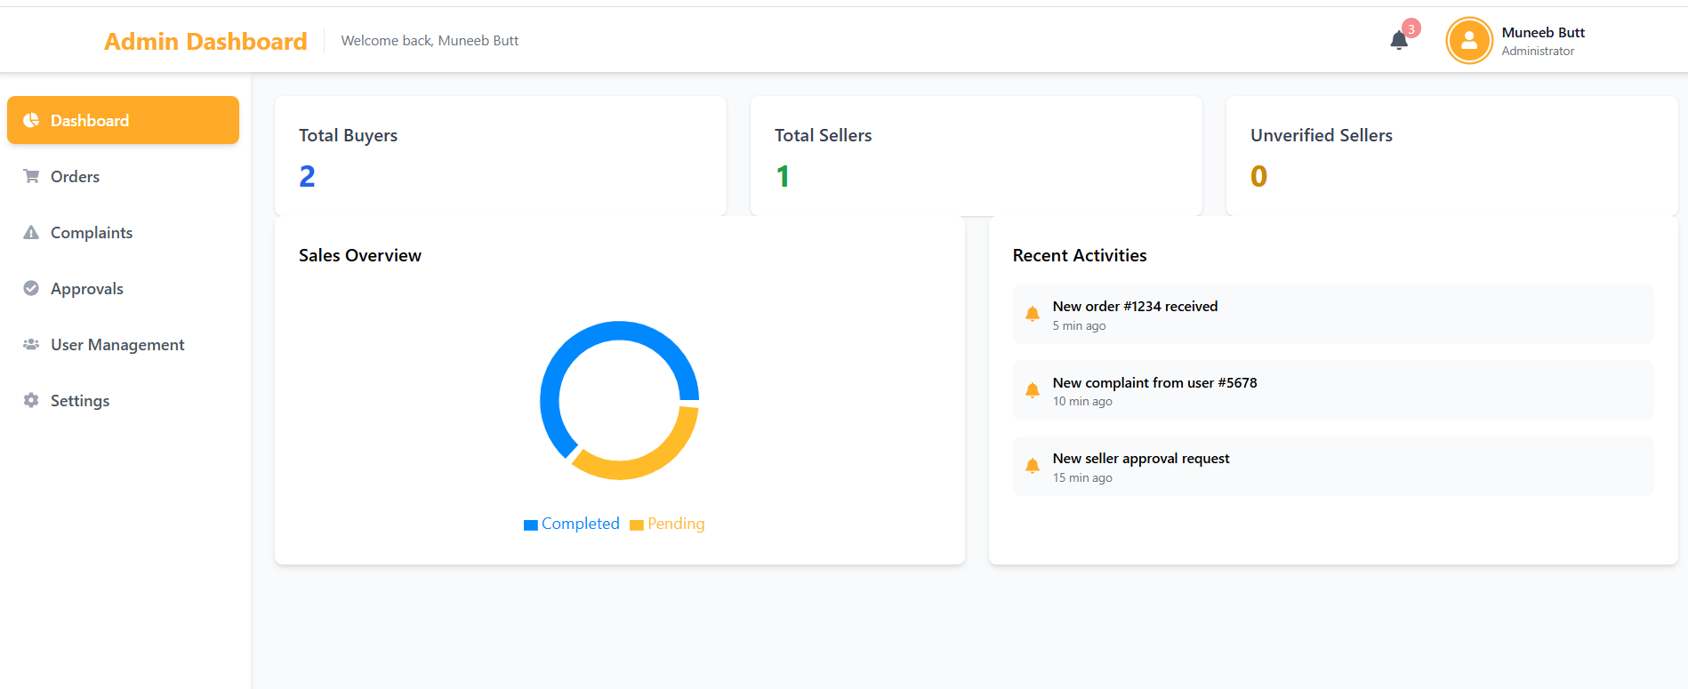
Tell Total Buyer
Tell Unverified Seller
Tell Total Seller
Explaining this in
Incoming slide

Slide 24
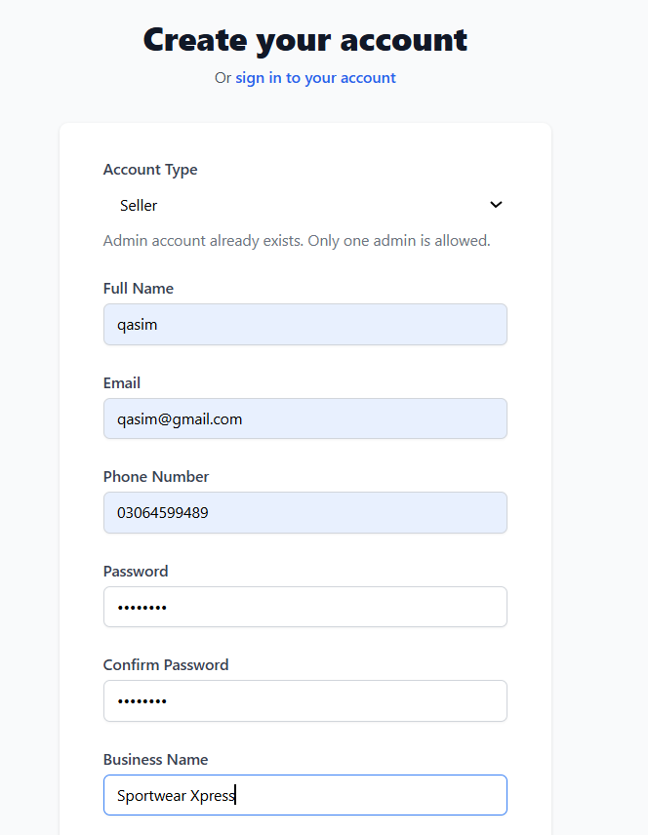
Sign up For Seller
Now Choosing the Seller for sign up

Slide 25
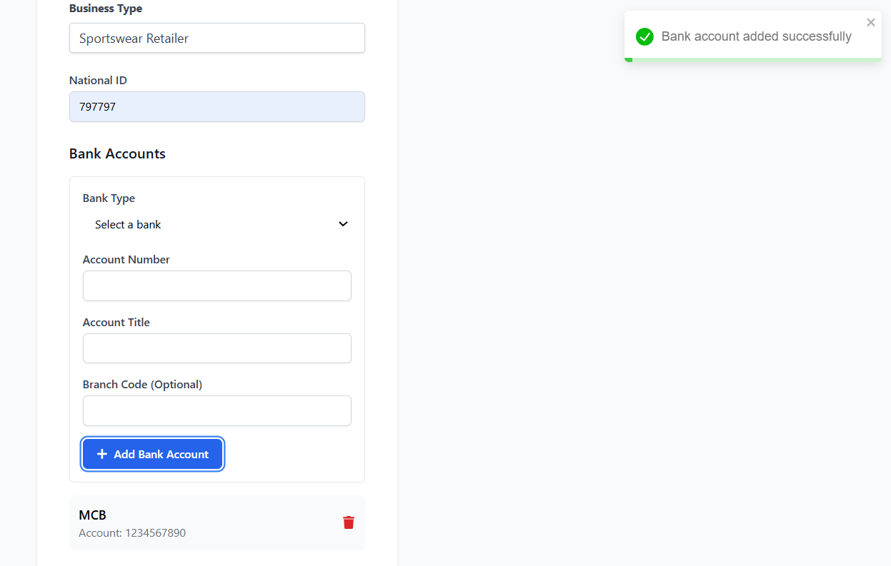
Same as Admin you can choose
bank or digital account

Slide 26
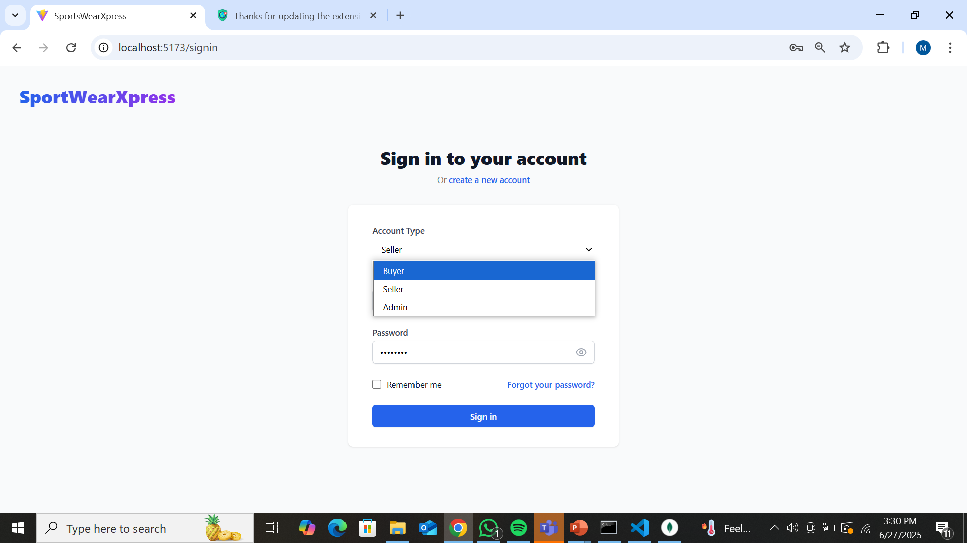
Chosing Seller During Login
After Correct Sign in the
Seller Dashboard opens

Slide 27
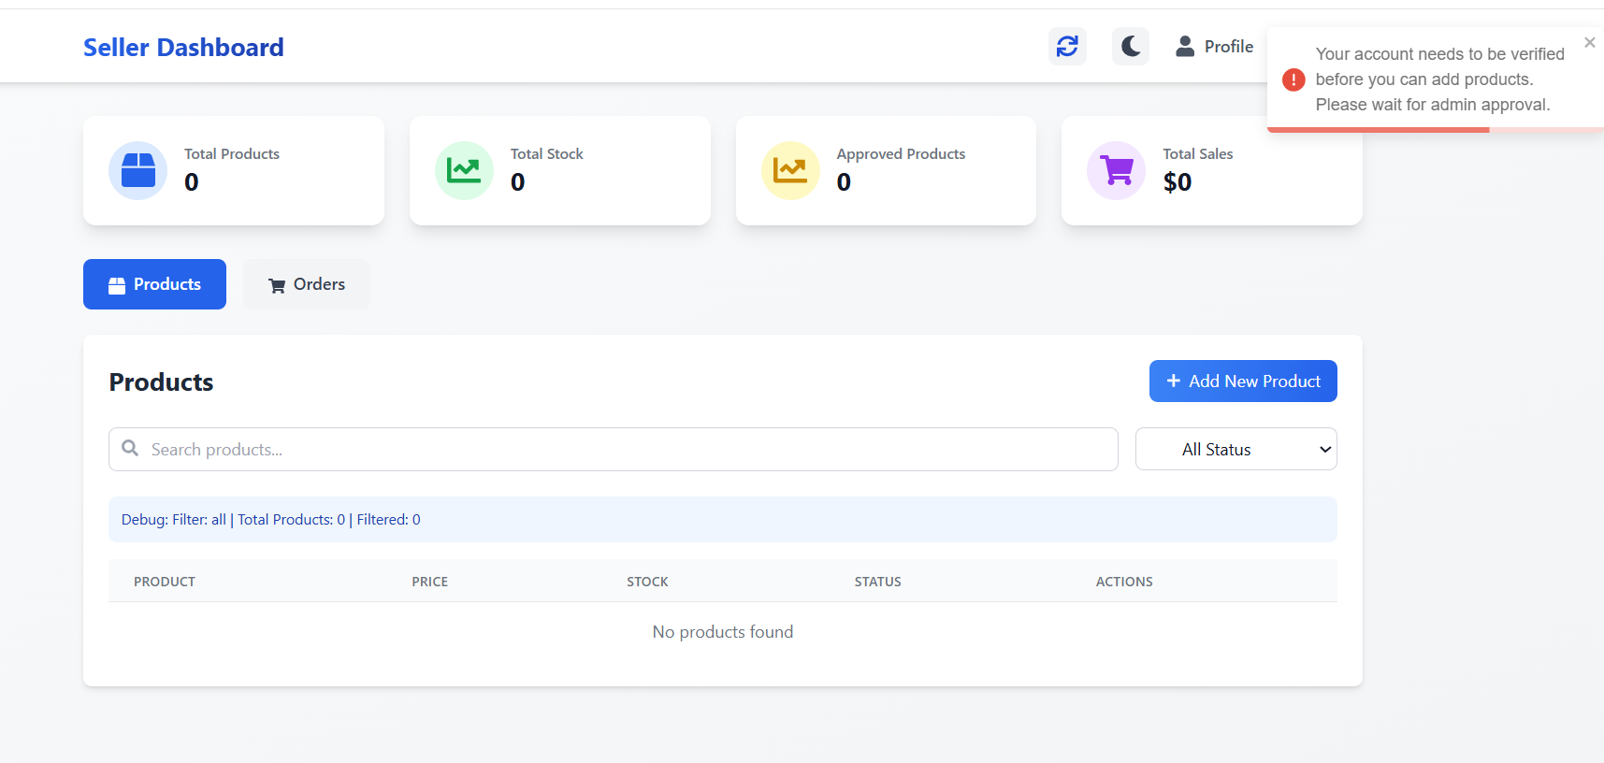
Product will not add until the
account is verified by Admin

Slide 28
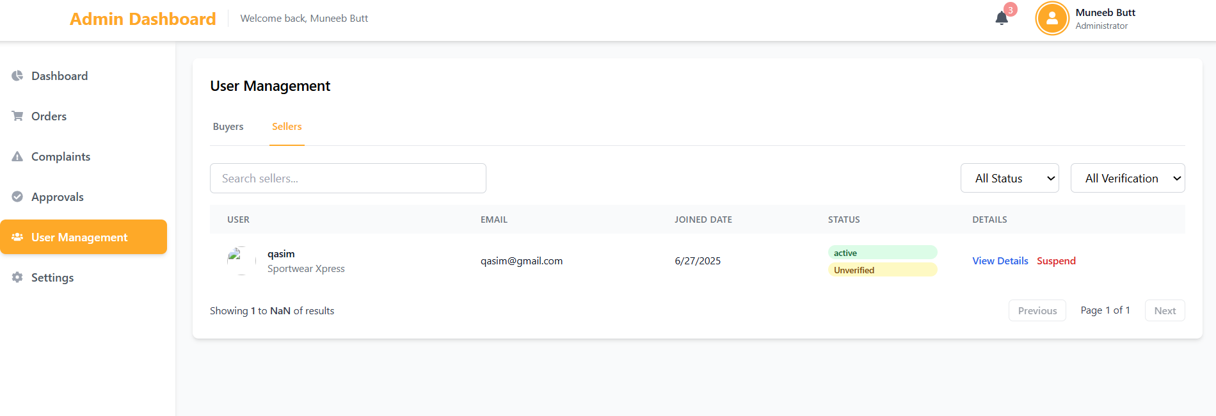
Admin will verify or
suspend Seller account

Slide 29
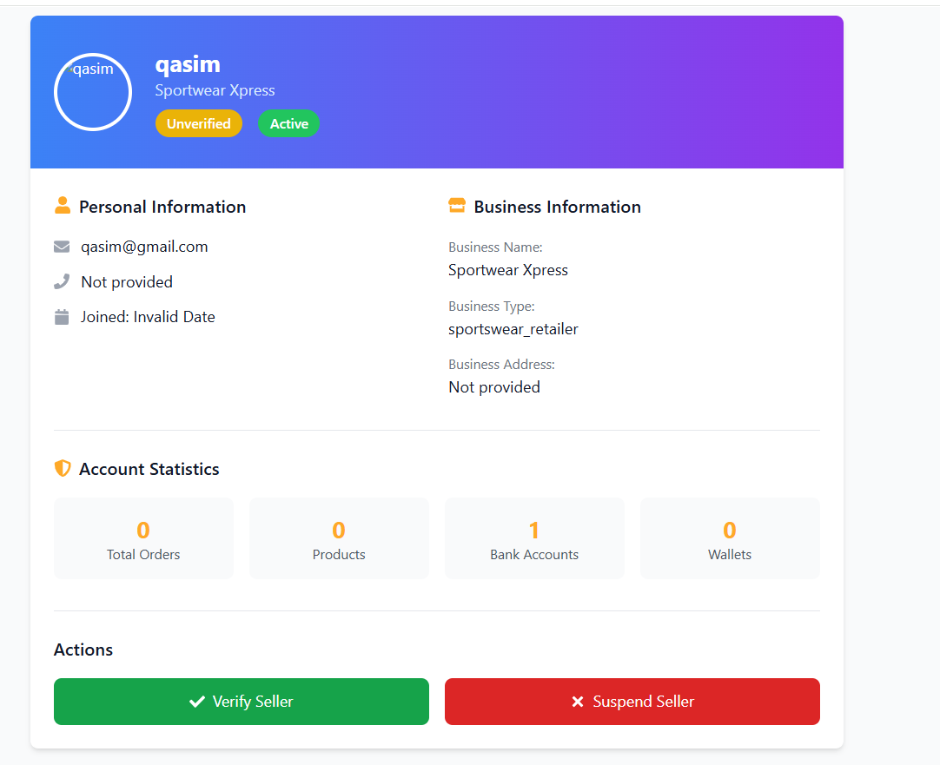
verifySeller
SuspendSeller

Slide 30
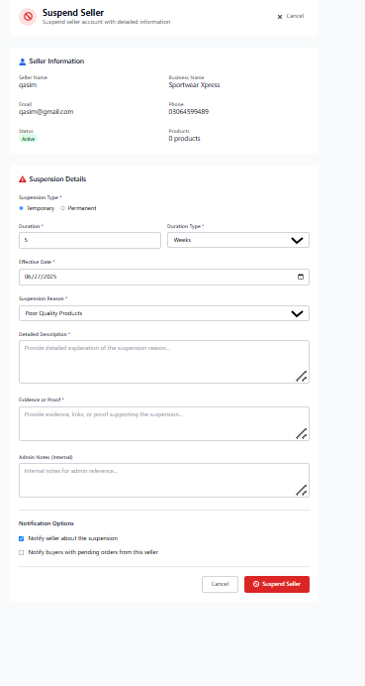
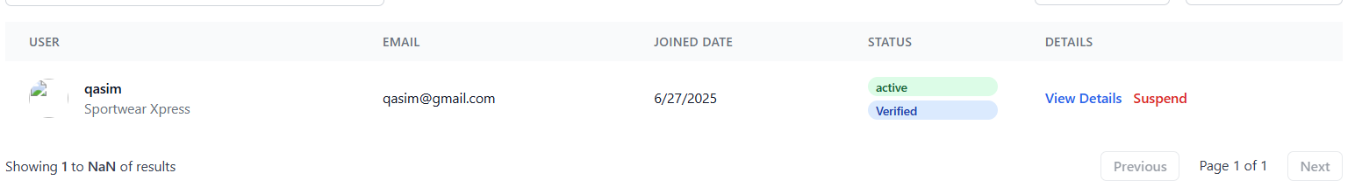
In case of suspend seller
In case of Approve seller Account

Slide 31
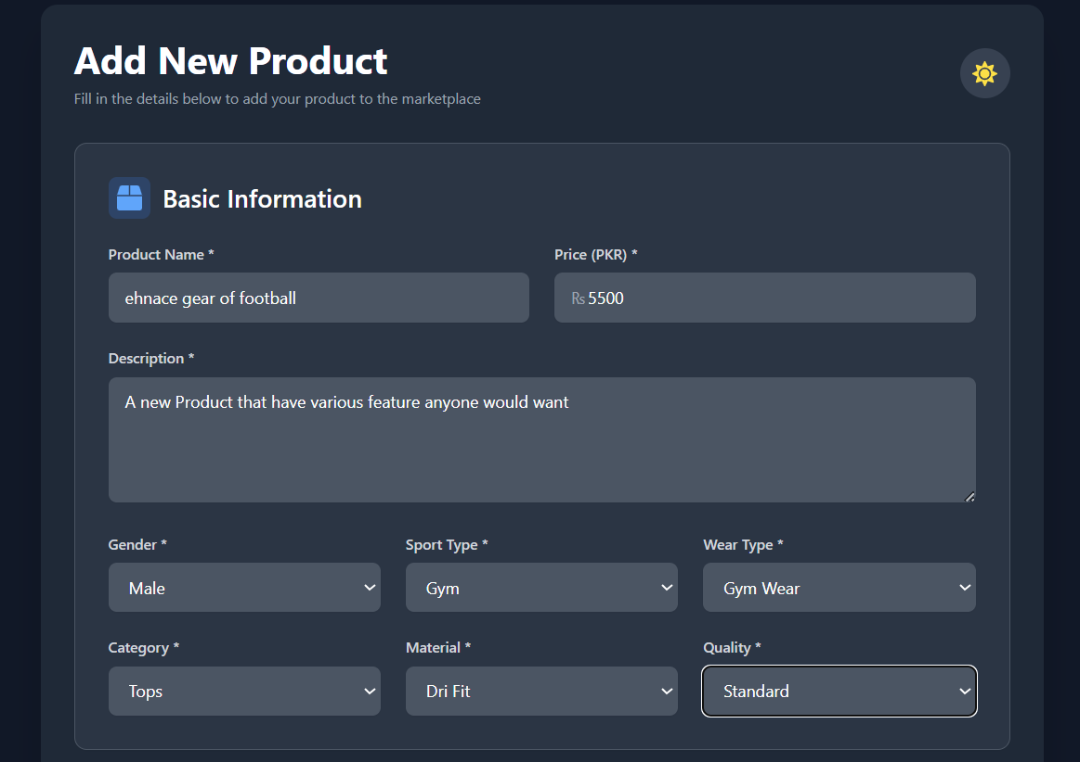

Slide 32
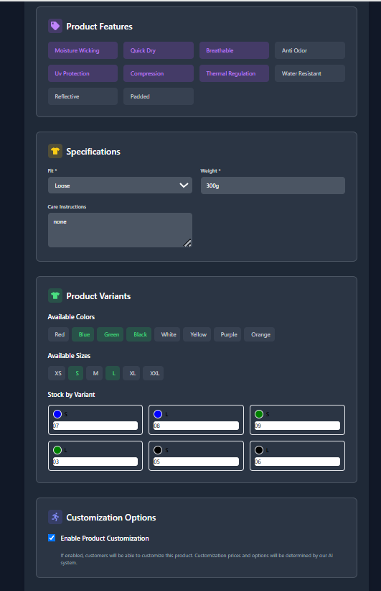
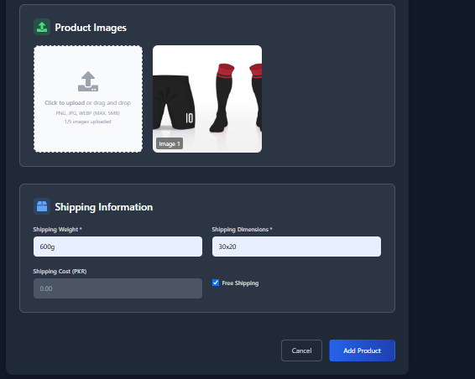

Slide 33
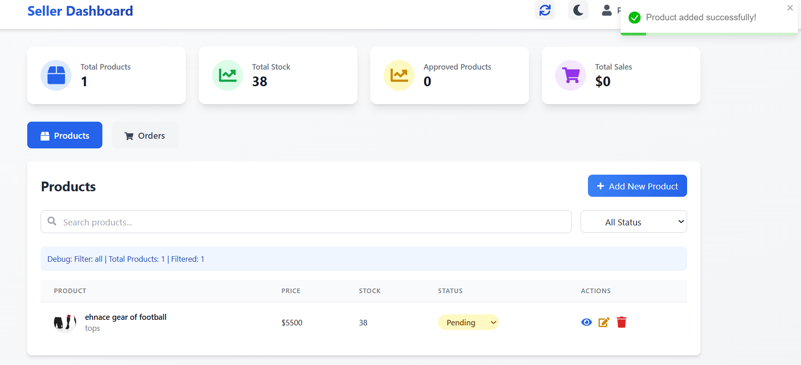
New Product has been added
We can Change the status of the
product to pending, Approved

Slide 34
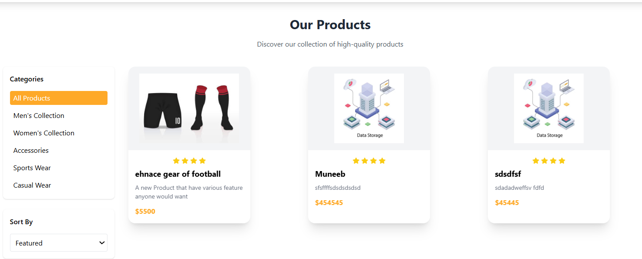
Seller all Product

Slide 35
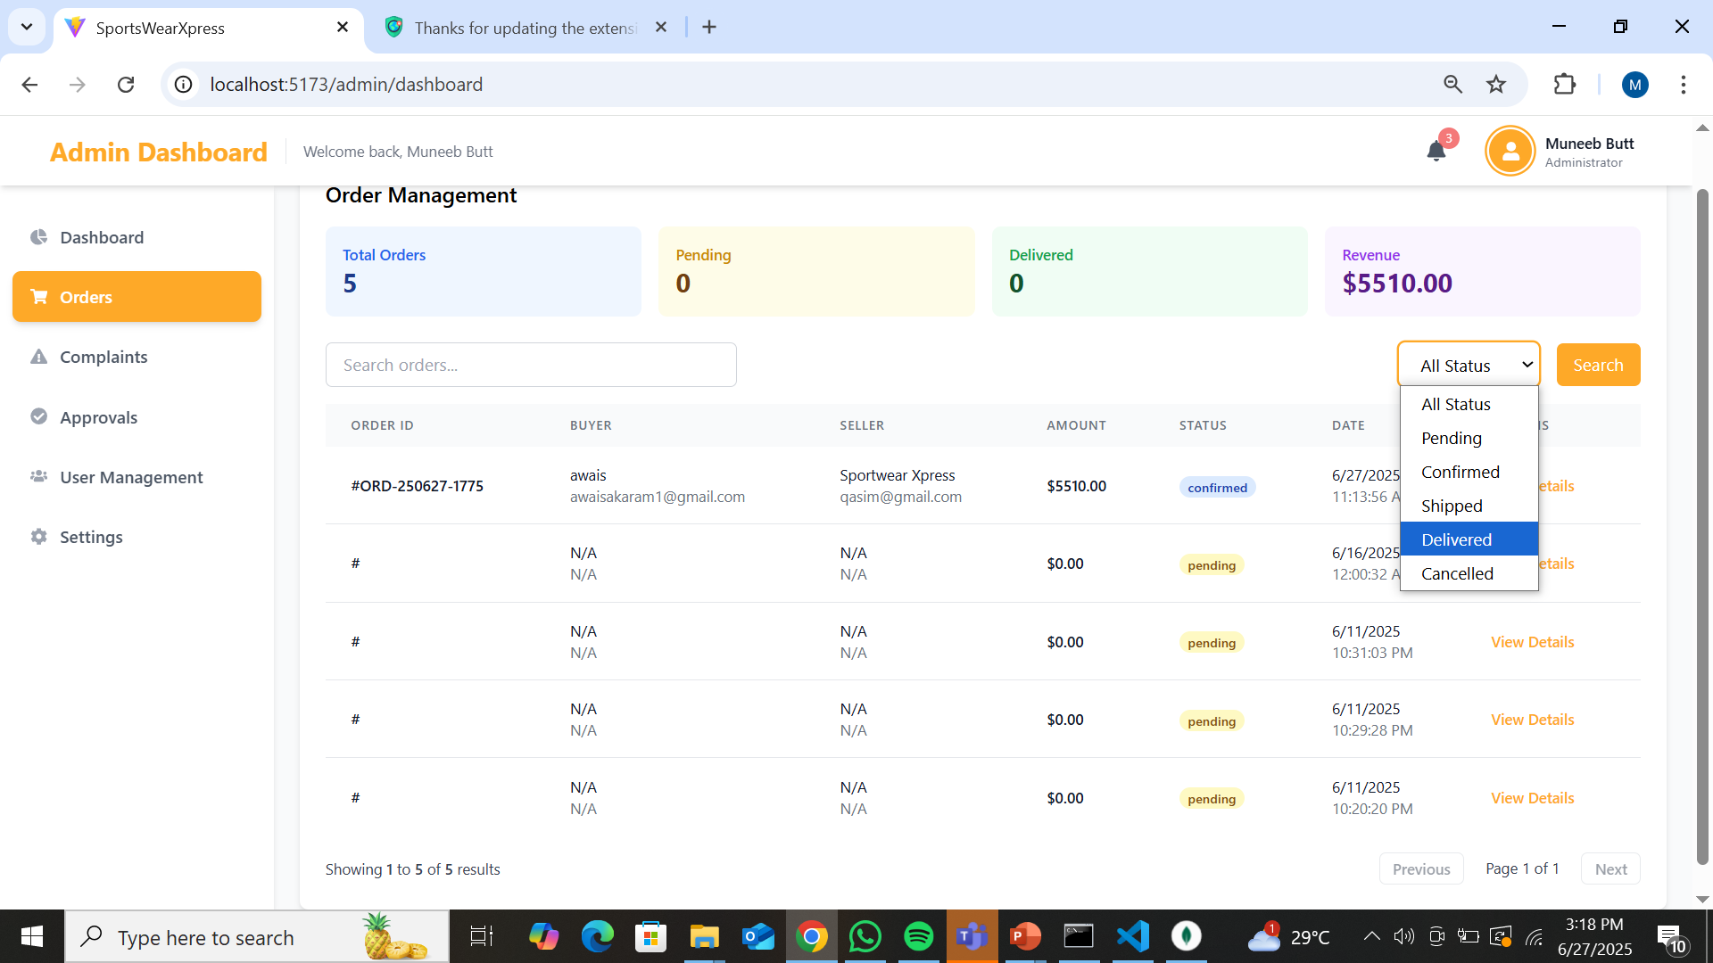
Tell Total Orders
Choose any To see

Slide 36
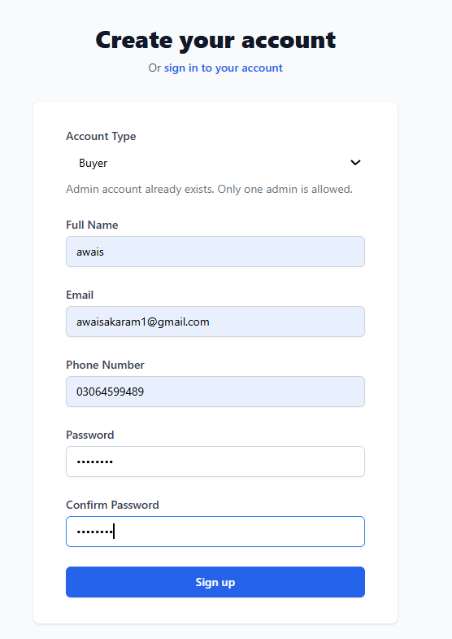
Sign up For Buyer

Slide 37
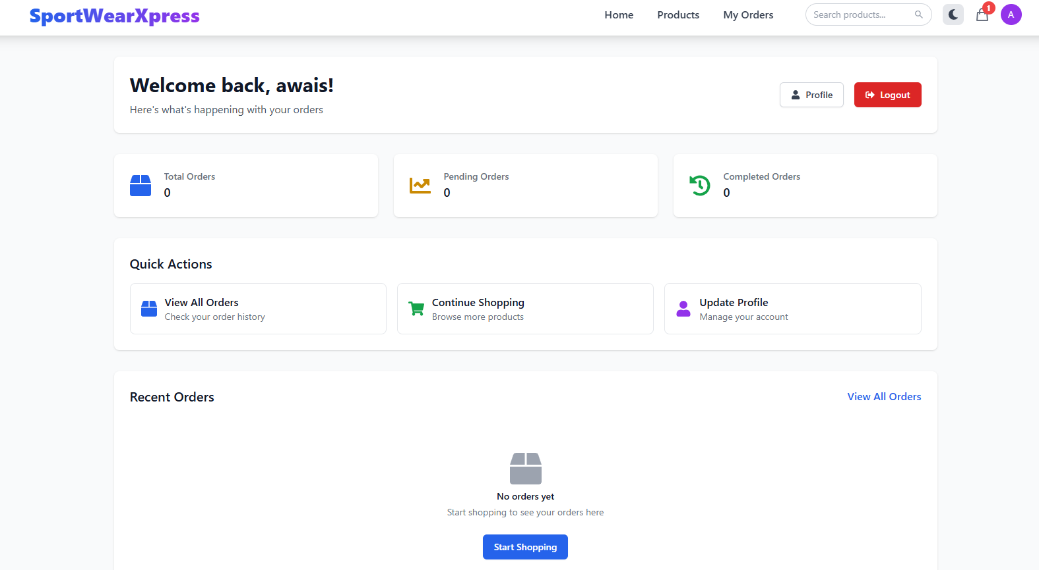

Slide 38
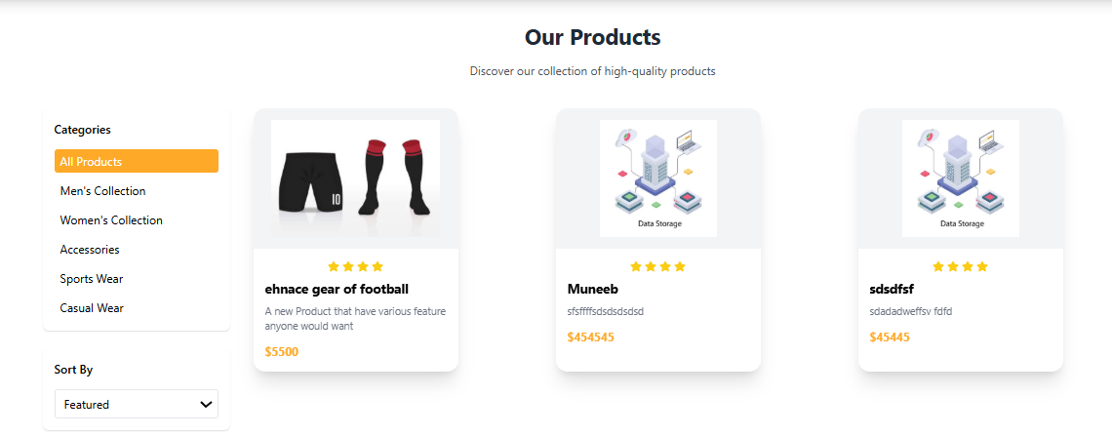

Slide 39
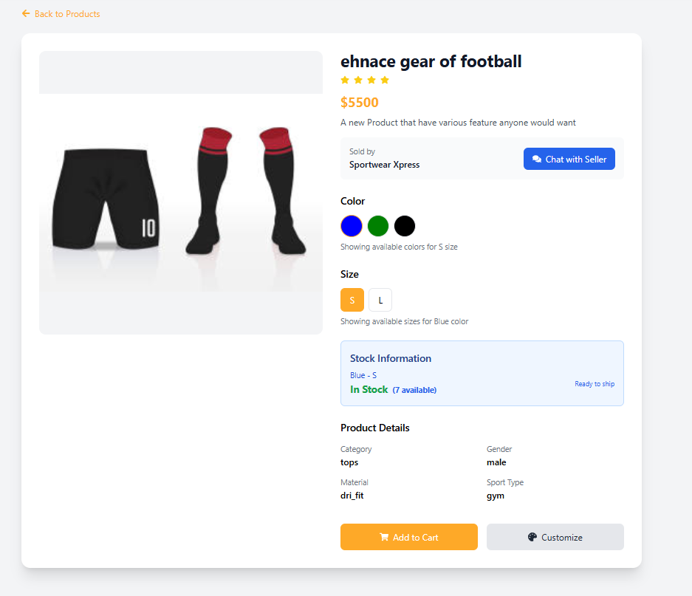
Adding to cart

Slide 40
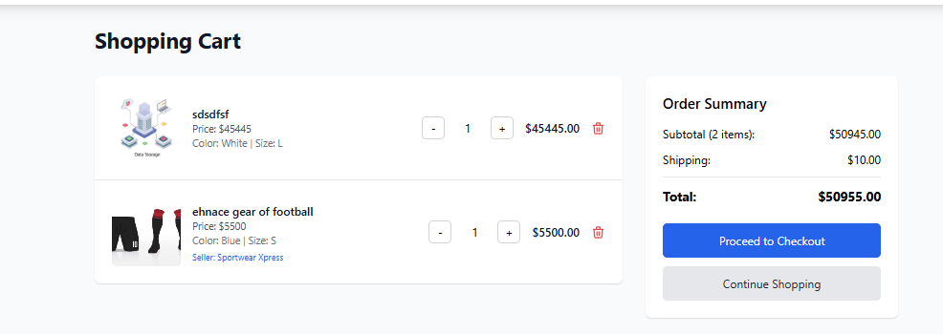
Going to Checkout

Slide 41
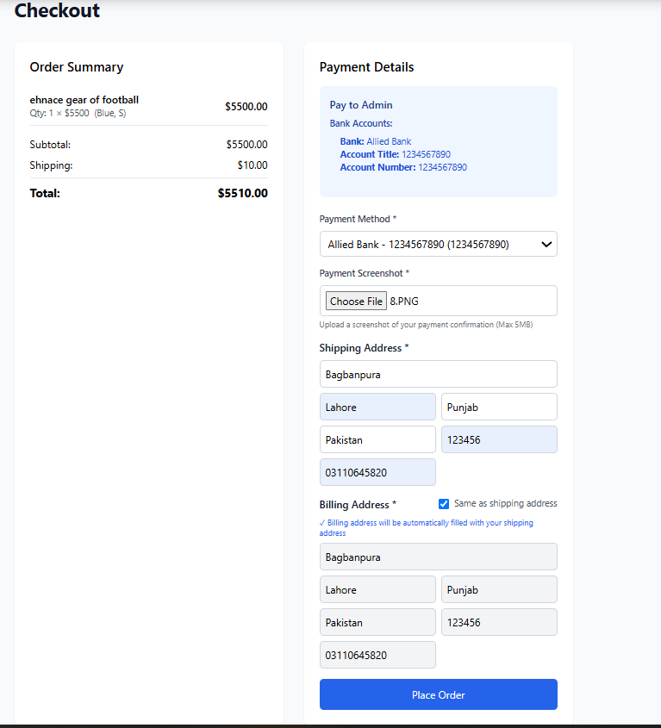
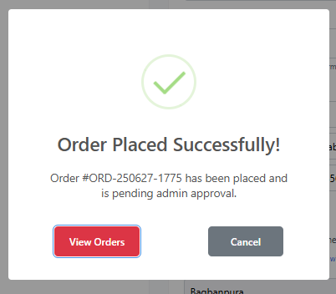
Placing Order

Slide 42
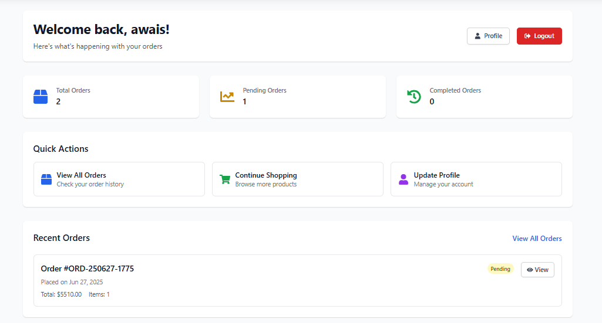
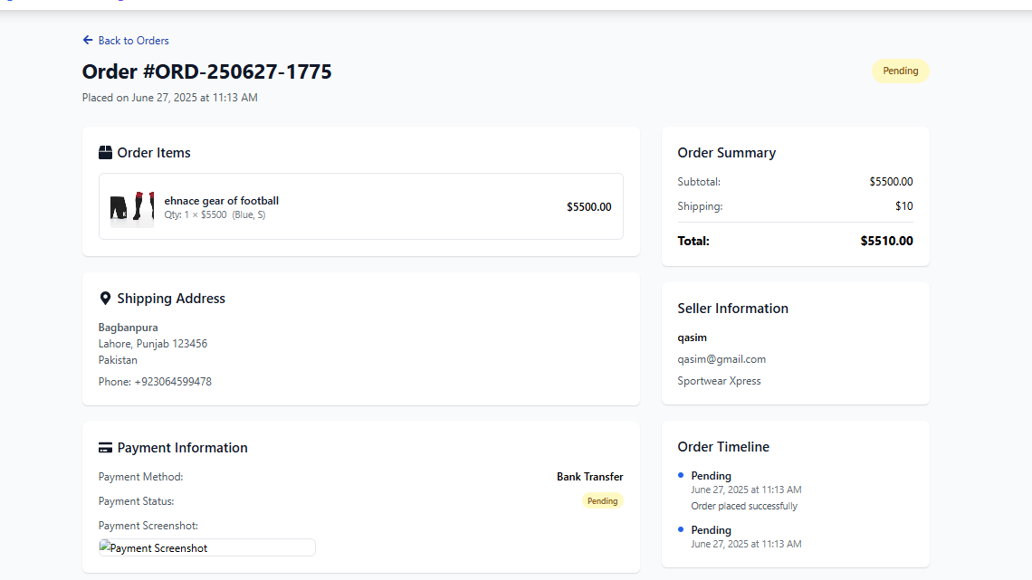
After The buyer buy the details come to seller dashboard
Order Details
By clicking the View all Orders

Slide 43
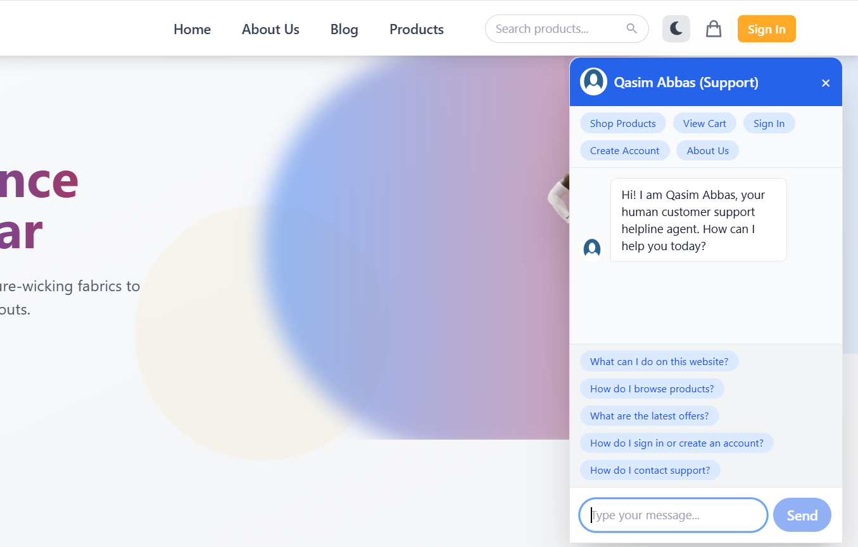
AI Chatbot
Every Page have Different Questions
According to the type of the page

Slide 44
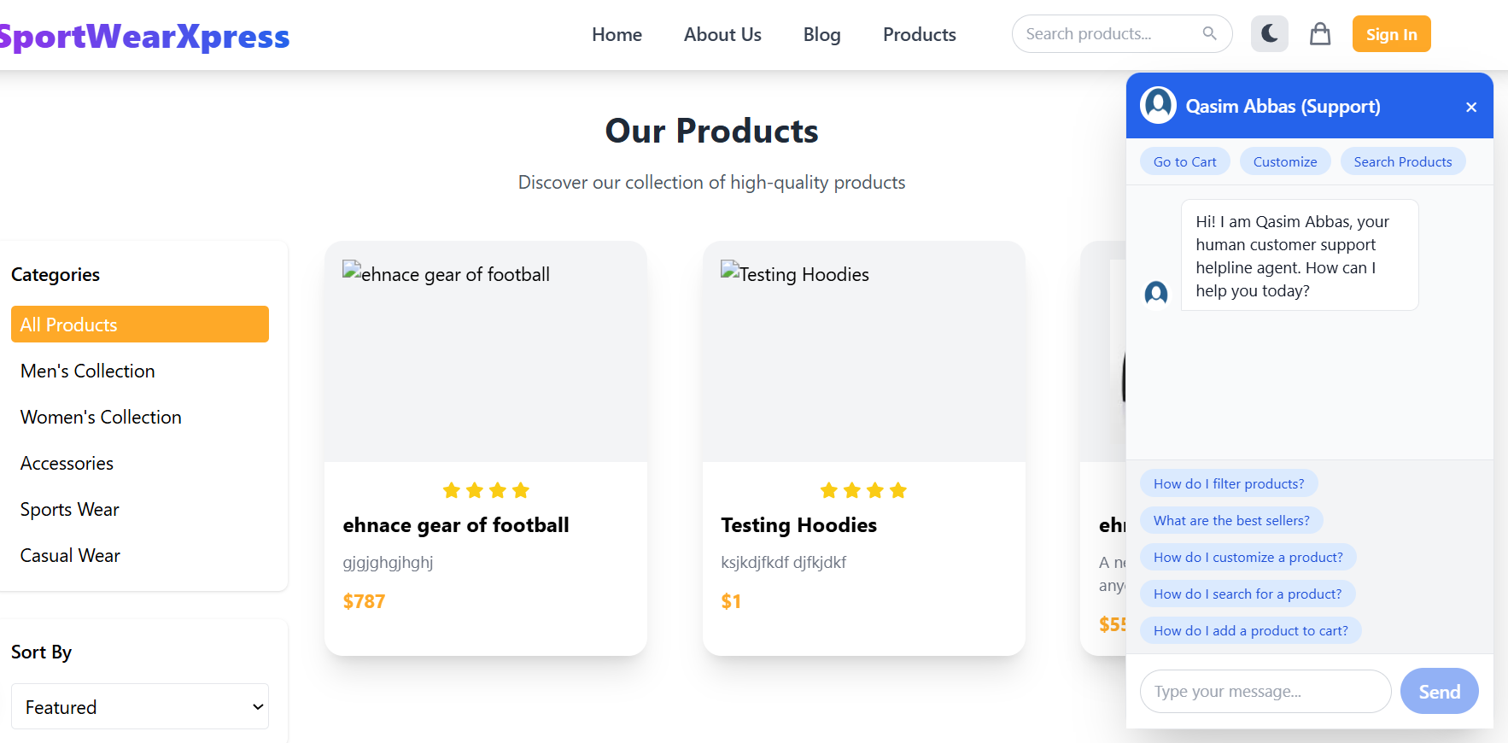
Now I go to seller page all the
questions are related to products

Slide 45
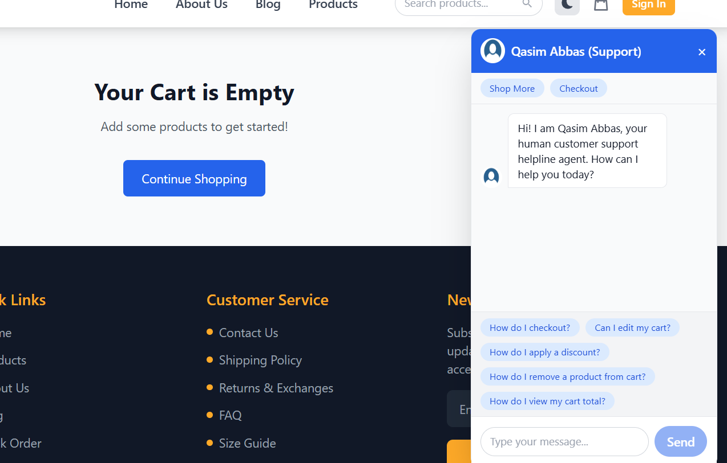
Another Example

Slide 46
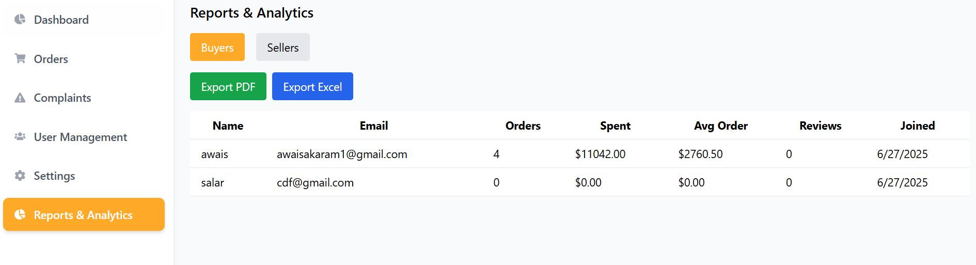
Export Excel
Export Pdf

Slide 47
RELATED PROJECTS
Custom Link
1
It enables custom apparel design but lacks advanced AI and seamless e-commerce integration.
Zazzle
2
Provides customization, but lacks AI and real-time communication.
Teespring
3
Offers basic custom design tools but lacks advanced AI and robust communication features.
SportWearXpress

Slide 48
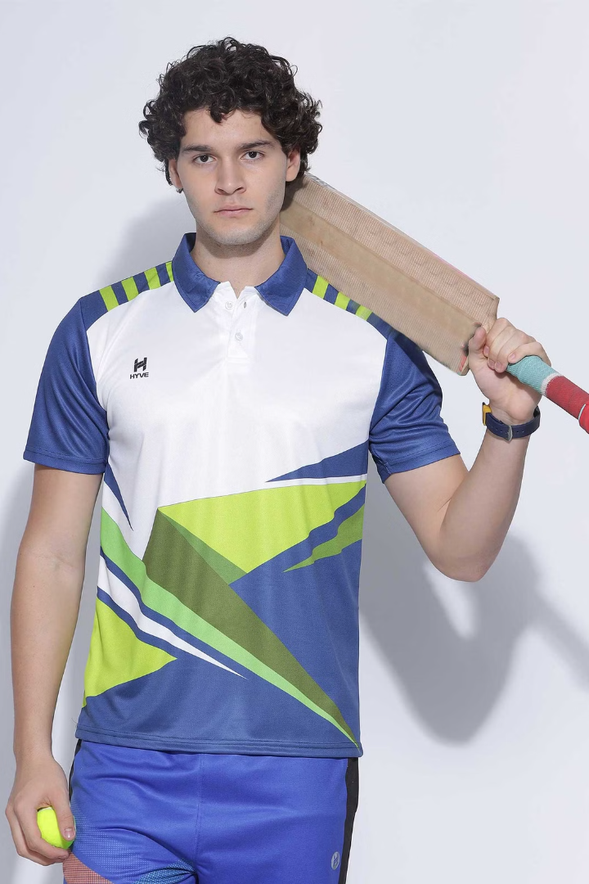
Conclusion
SportswearXpress uses AI to make sportswear customization easier and more efficient. With intelligent design tools, automated pricing, and real-time communication, users can create precise designs and interact seamlessly with sellers. This innovation improves user experience, reduces errors, and streamlines the entire customization process, setting a new standard in the industry.
SportWearXpress

